Slide 1
Dynamic White Box Testing – Code Coverage Analysis

Slide 2
Review: Static and Dynamic Testing
Static Testing
Testing something that is not running by examining and reviewing it.
Examples: Code inspections
Dynamic Testing
Testing software by running and using it.
Notes:
Analogy – buying used car. Static – kicking tires, looking under hood. Dynamic – test drive

Slide 3
Review: Black Box Testing
Tester knows what software is supposed to do, but cannot look in it (the box) to see how it operates.
Notes:
Risk – easy to become biased because tests may be tailored to match code’s operation

Slide 4
Review: White Box Testing
Tester has access to the code and can examine it for clues to help with the testing.
Tester may determine that certain conditions are more or less likely to fail and tailor testing based on that.
Notes:
Risk – easy to become biased because tests may be tailored to match code’s operation

Slide 5
Dynamic White Box Testing
Also called structural testing
Using information gained from seeing what the code does and how it works to determine what to test, what not to test, and how to approach the testing

Slide 6
Code Coverage and Code Coverage Analysis
Code Coverage is a measurement of how many lines/blocks/arcs of your code are executed while the automated tests are running.
Code Coverage Analysis is a white box testing technique. It is the process of analyzing code, with code coverage in mind, in hopes in creating meaningful and thorough test cases

Slide 7
What is CCA good at?
Finding areas of a program not exercised by a set of test cases
Creating additional test cases to increase coverage
Determining a quantitative measure of code coverage, which is an indirect measure of quality.
Optional:
Identifying redundant test cases that do not increase coverage.

Slide 8
CCA Assumptions
The basic assumptions behind coverage analysis tell us about the strengths and limitations of this testing technique
Bugs relate to control flow and you can expose Bugs by varying the control flow (if (x=0) vs if(x != 0)
The tester understands what a correct version of the program would do and can identify differences from the correct behavior.
Achievable specifications, no errors of omission, and no unreachable code.

Slide 9
Basic Metrics
A large variety of coverage metrics exist.
Statement Coverage
Decision Coverage
Condition Coverage
Path Coverage

Slide 10
Statement Coverage
Covers every line of code
Also known as line coverage
Does not care about logical operations, just that in covers each line at least once
Only covers true conditions

Slide 11
Statement Coverage Example
if(a || b))
test1 = true;
else if(c)
test2 = true
T1: a = true, b=false
T2: a=false, b =false, c=true

Slide 12
Interaction – Partner up
How many test cases are needed to cover the following using statement coverage?
int function(int a, int b)
int c=0;
if(a > b || a ==b)
c = 100;
if(c > a || b > a)
c = 10;
if(b > 10)
c = 1000;
if(a > 100)
c = 10000;
return c;

Slide 13
Decision Coverage
Identifies each decision that can be true/false (do-while, if/else, case)
Makes sure every true/false consider has been met
Different from statement coverage as it looks at false conditions as well

Slide 14
Decision Coverage Example
if(a || b))
test1 = true;
else if(c)
test2 = true
T1: a = true, b=false
T2: a=false, b =false, c=true
T3: a=false, b =false, c=false

Slide 15
Interaction – Partner up
How many test cases are needed to cover the following using decision coverage?
int function(int a, int b)
int c=0;
if(a > b || a == b)
c = 100;
if(c > a || b > a)
c = 10;
if(b > 10)
c = 1000;
if(a > 100)
c = 10000;
return c;

Slide 16
Condition Coverage
Identifies each decision that can be true/false (do-while, if/else, case)
Makes sure every variation of true/false has been considered
Different from decision coverage as it includes alternate paths to same condition

Slide 17
Condition Coverage Example
if(a || b))
test1 = true;
else if(c)
test2 = true
T1: a = true, b=false
T2: a=false, b =false, c=true
T3: a=false, b =false, c=false
T4: a = false, b=true

Slide 18
Interaction – Partner up
How many test cases are needed to cover the following using condition coverage?
int function(int a, int b)
int c=0;
if(a > b || a ==b)
c = 100;
if(c > a || b > a)
c = 10;
if(b > 10)
c = 1000;
if(a > 100)
c = 10000;
return c;

Slide 19
Path Coverage
Identifies every possible path in a program
Has test cases for each path, not just each condition
Different from condition coverage as it covers paths, not conditions

Slide 20
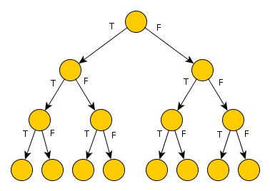
Path Coverage Example
public int returnInput(int input, boolean condition1, boolean condition2, boolean condition3) {
int x = input;
int y = 0;
if (condition1)
x++;
if (condition2)
x--;
if (condition3)
y=x;
return y;
}

Slide 21
Interaction – Partner up
How many test cases are needed to cover the following using path coverage?
int function(int a, int b)
int c=0;
if(a > b || a ==b)
c = 100;
if(c > a || b > a)
c = 10;
if(b > 10)
c = 1000;
if(a > 100)
c = 10000;
return c;

Slide 22
Cyclomatic Complexity
Cyclomatic complexity is a software metric used to measure the complexity of a program. These metric, measures independent paths through program source code.
Higher Cyclomatic complexity has been linked to higher risks of coding errors
It is calculated by developing a Control Flow Graph of the code that measures the number of linearly-independent paths through a program module.

Slide 23
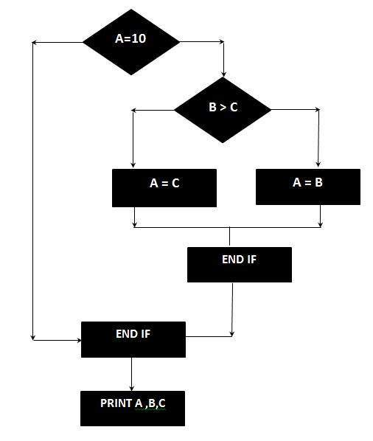
Control Flow Graph
IF A = 10 THEN
IF B > C THEN
A = B
ELSE
A = C
ENDIF
ENDIF
Print A
Print B
Print C

Slide 24
Cyclomatic Complexity Calculation
Cyclomatic complexity = E - N + 2*P
where,
E = number of edges in the flow graph. (lines)
N = number of nodes in the flow graph. (shapes)
P = number of nodes that have exit points

Slide 25
Cyclomatic Complexity Calculation
The Cyclomatic complexity is calculated: E = 8
N = 7
P = 1
CCC = 8 – 7 + 2*1 = 3

Slide 26
Interaction – Partner up
Calculate the Cyclomatic Complexity:
IF A = 10 THEN
IF B > C THEN
return;
ELSE
A=B;
ENDIF
ENDIF
return;

